Slide 1




Risk Assessment using Early Requirements Models
Adaptive Information Security for the Cloud
Dr. Yijun Yu
The Open University, UK
http://mcs.open.ac.uk/yy66
5 September 2017 @ Lisbon, Tutorial, RE 2017

Slide 2
Yijun YU
WeChat：xihuatech (嘻话Tech)
1988-1998 Fudan University, Shanghai, China
1991-1995 Jadebird CASE Environment with Peking University
Structured Analysis and Design CASE tools
1999-2002 Ghent University, Belgium
2003-2006 University of Toronto, Canada
Since 2006: The Open University, UK
Since 2007: Collaborating with NII, Japan
Interests: High Trustworthy and Dependability
Parallelizing Compiler for High Performance
Software Maintenance for High Productivity
Requirements Engineering for High Quality
Self-Tuning and Self-Optimizations with High Variability
Software Engineering for Aviation Safety
Argumentation for Security and Privacy Risks

Slide 3
Yijun YU
WeChat：xihuatech (嘻话Tech)
1988-1998 Fudan University, Shanghai, China
1991-1995 Jadebird CASE Environment with Peking University
Structured Analysis and Design CASE tools
1999-2002 Ghent University, Belgium
2003-2006 University of Toronto, Canada
Since 2006: The Open University, UK
Since 2007: Collaborating with NII, Japan
Interests: High Trustworthy and Dependability
Parallelizing Compiler for High Performance
Software Maintenance for High Productivity
Requirements Engineering for High Quality
Self-Tuning and Self-Optimizations with High Variability
Software Engineering for Aviation Safety
Argumentation for Security and Privacy Risks

Slide 4
Shall I take a flight ?
My first flight from Shanghai to Beijing, 25 years ago.
It is important for the Jadebird team to demonstrate a CASE tool (Structured Analysis) I programmed …
However, there was a bug, a show stopper, one day before the demo to the Chinese Minister of Science and Technology …
If I take a train instead, it will be slow, and the demo will be a failure ...
I risked my life (rather young) to go to PKU …
As a result, the project had won a number of awards in China and I joined the SE group as a MSc student.
Today’s talk is my personal reflection of 25 years

Slide 5
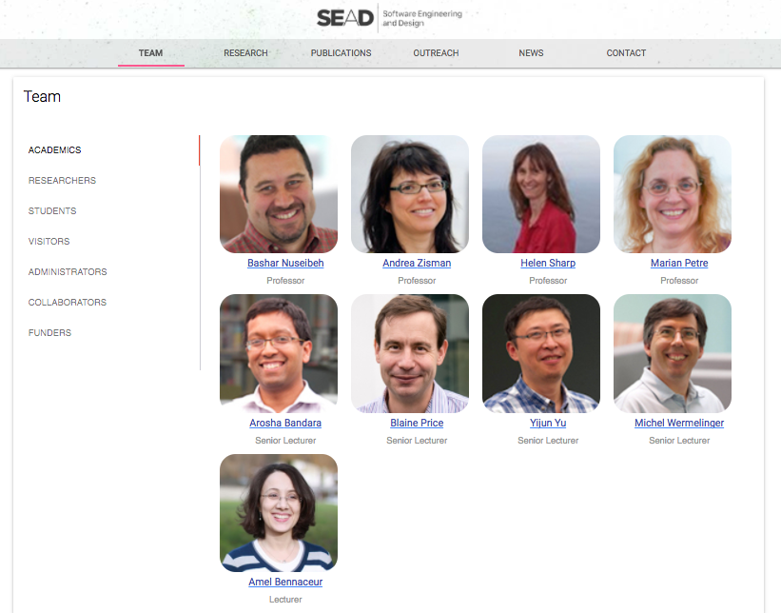
Recruiting…

Slide 6
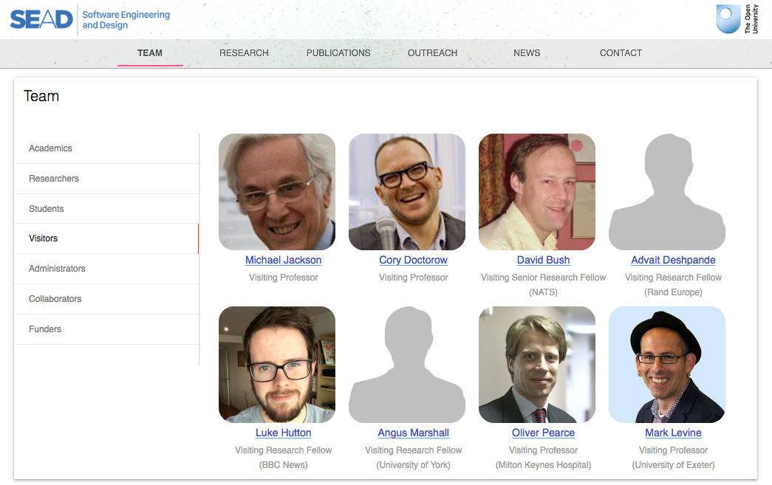

Slide 7
In Requirements We Trust
Bashar Nuseibeh, Charles B. Haley, Craig Foster (2009). “Securing the Skies: In Requirements We Trust”. IEEE Computer 42(9):64-72.
Toulmin Argumentation (a.k.a. dual diligence) (claim, rebuttal, mitigation) [TSE’08]
Risk and argumentation (RE’11 Distinguished Paper)
SecureChange, an EU project with Deep Blue and Rome Airport
Adaptive Security and Privacy, an ERC Adv. Grant
Adaptive Information Security for the Cloud, an QNRF Grant

Slide 8
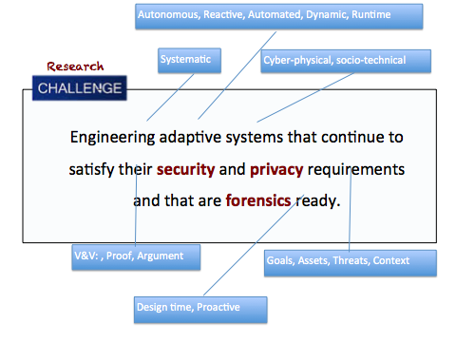

Slide 9
Risk Assessment using Early Requirements Models
Adaptive Information Security for the Cloud
Dr. Yijun Yu
The Open University, UK
http://mcs.open.ac.uk/yy66
5 September 2017 @ Lisbon, Tutorial, RE 2017

Slide 10
Life is full of risks
FSE and RE are held in the same week
London => Dusseldorf => Paderborn => talk
Parderborn => Dusseldorf => London => Lisbon
From Dusseldorf to Lisbon via London
I have one hour in flight connection
Flight BA943 was delayed by 30 minutes
Shuttle Bus from Terminal 5 to Terminal 3 was delayed by 22 minutes
…fortunately, BA504, the flight from London to Lisbon was also delayed by 10 minutes, so I am here ☺
Why are FSE/RE scheduled on the same week?

Slide 11


Which one is more deadly?

Slide 12
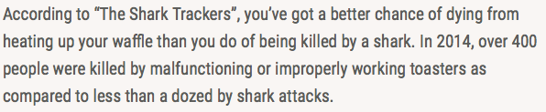

Perceived Risks

Slide 13

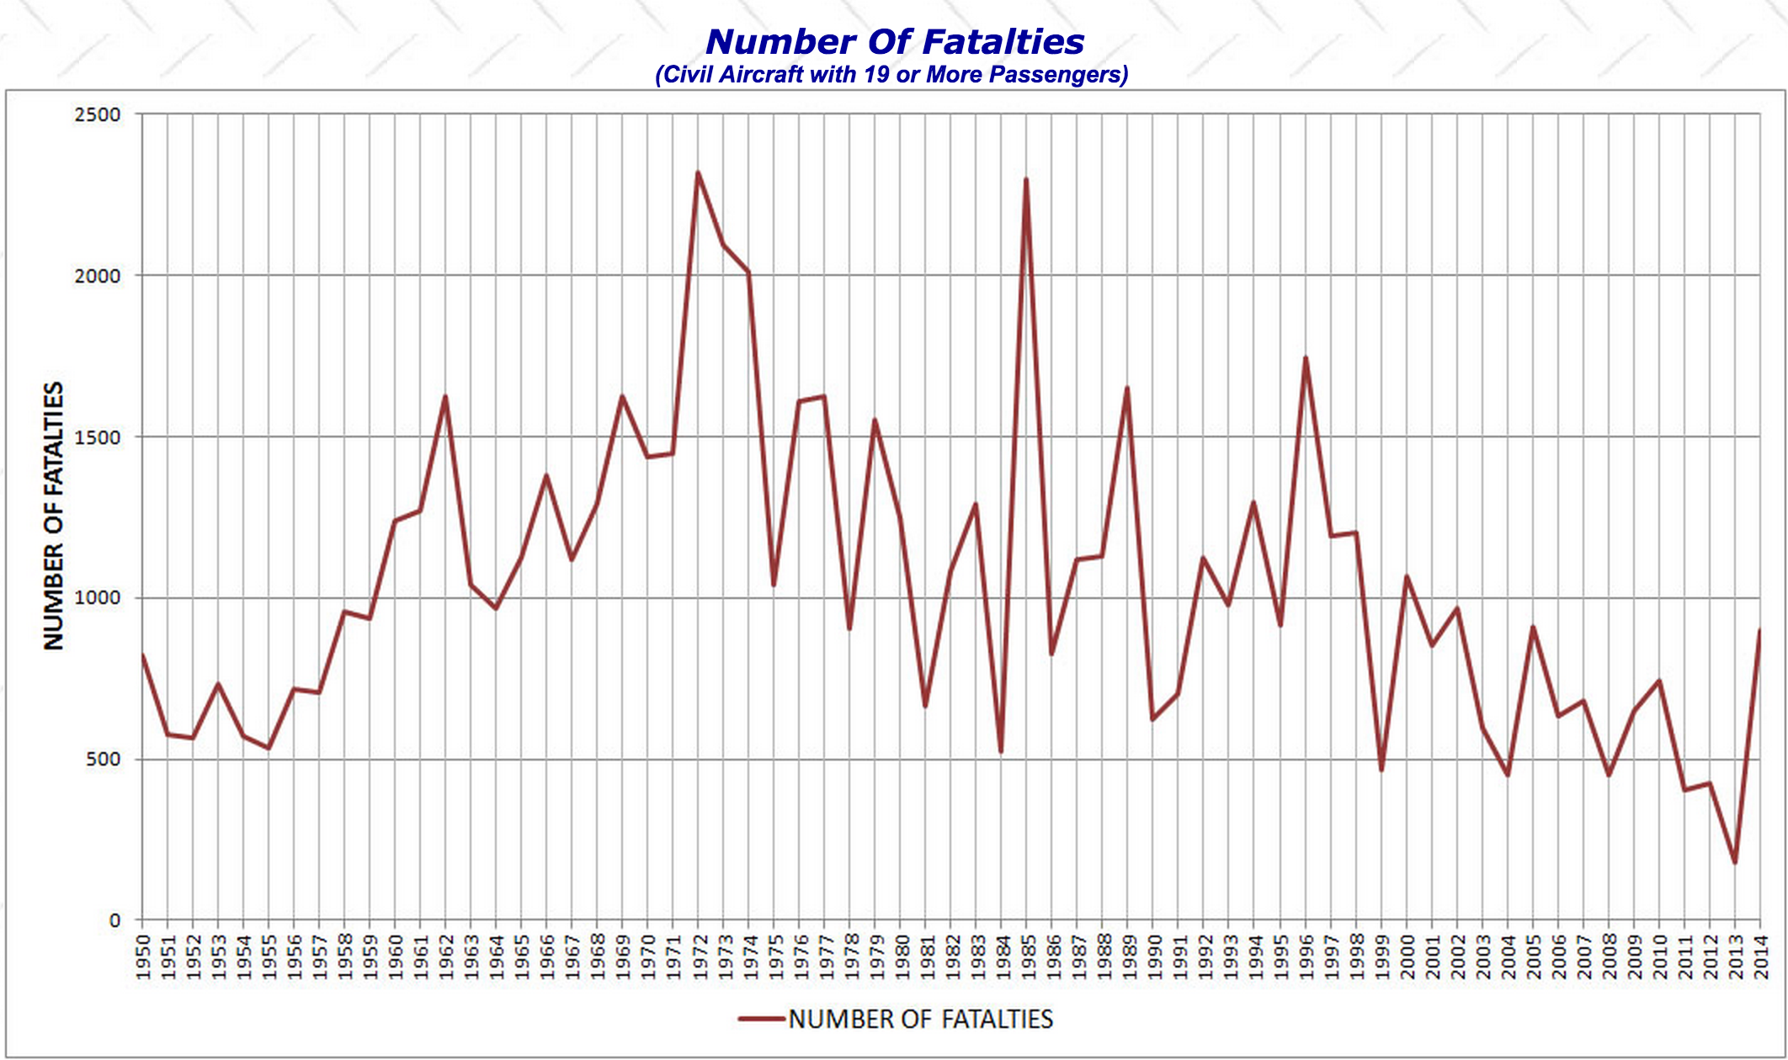
Death tolls of flights

Slide 14
A Guided Tour
Risks in life
Qualitative Risk Assessment based on Requirements
Quantitative Risk Assessment based on Requirements
Abstract Goal Behaviors and the Right Hand Side Problems
Quantitative Risk Assessment based on Probabilistic Behavior Models and Requirements
Risk Assessment for Requirements-Driven Self-Adaptive Systems

Slide 15
Safer to take planes
Driving cars is much more dangerous.
Would self-driving cars be safer?
Yet to know.
It depends.
How much autonomy men shall give to machine?
NASA, Russia Space Agency, Chinese Space Agency
Shall Manned Space Vehicles be controlled by Ground Controls?
Shall Manned Space Vehicles be controlled by Robots?

Slide 16
Exercise 1
What’s your rationale when deciding to take flight for the first time in your life?
Do you calculate the risk?
What factors were used in your calculations?
Discuss in pairs (for 5 minutes)

Slide 17
A Guided Tour
Risks in life
Qualitative Risk Assessment based on Requirements
Quantitative Risk Assessment based on Requirements
Abstract Goal Behaviors and the Right Hand Side Problems
Quantitative Risk Assessment based on Probabilistic Behavior Models and Requirements
Risk Assessment for Requirements-Driven Self-Adaptive Systems

Slide 18
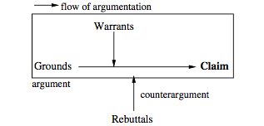
Risks and Arguments
Security requirements: protecting assets from malicious attacks
Risks are important to assess the satisfaction argument of security requirements
Using Argumentation to Explain Ambiguity in Requirements Elicitation Interviews by Yehia Elrakaiby, Alessio Ferrari, Paola Spoletini, Stefania Gnesi and Bashar Nuseibeh

Slide 19
How to Assess Risks from Requirements Satisfaction Arguments?
Charles B. Haley, Robin C. Laney, Jonathan D. Moffett, Bashar Nuseibeh: Security Requirements Engineering: A Framework for Representation and Analysis. IEEE Trans. Software Eng. 34(1): 133-153 (2008)
Yijun Yu, Thein Than Tun, Alessandra Tedeschi, Virginia N. L. Franqueira, Bashar Nuseibeh: OpenArgue: Supporting argumentation to evolve secure software systems. RE 2011: 351-352
Virginia N. L. Franqueira, Thein Than Tun, Yijun Yu, Roel Wieringa, Bashar Nuseibeh: Risk and argument: A risk-based argumentation method for practical security. RE 2011: 239-248
Yijun Yu, Virginia N. L. Franqueira, Thein Than Tun, Roel Wieringa, Bashar Nuseibeh: Automated analysis of security requirements through risk-based argumentation. Journal of Systems and Software 106: 102-116 (2015)

Slide 20
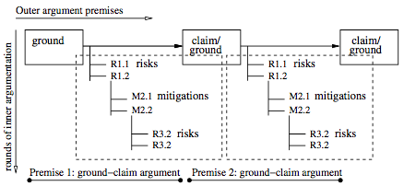
Risks ~ Rebuttals

Slide 21
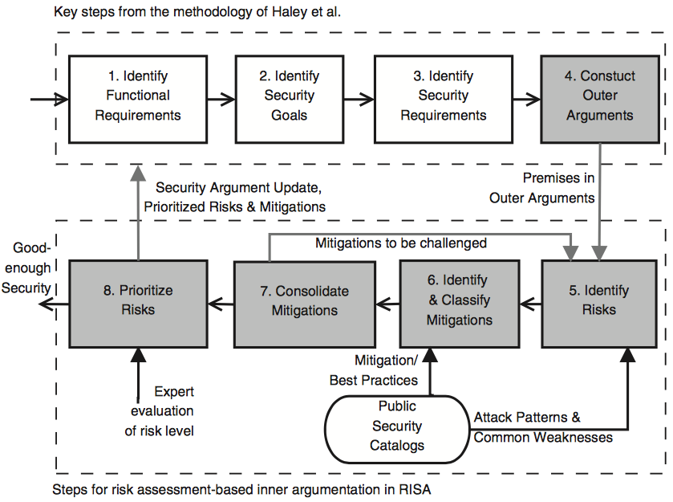
Risk and Argument (RISA)

Slide 22
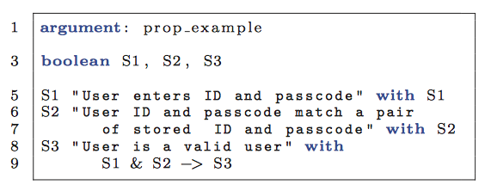
DSL

Slide 23
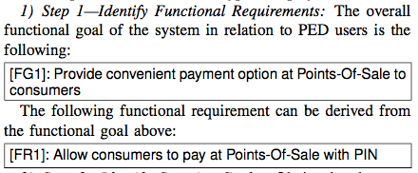
PIN Entry Device (PED) example

Slide 24
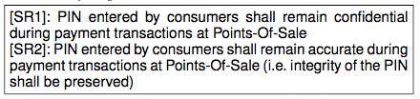
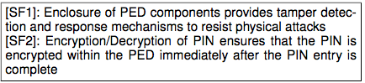
Identify Security Requirements and Security Functionality

Slide 25
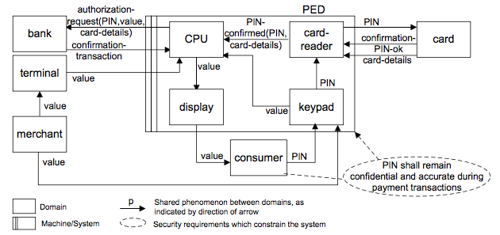

Slide 26
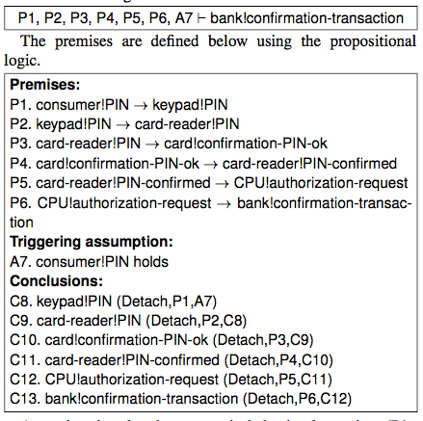
Outer Argument

Slide 27
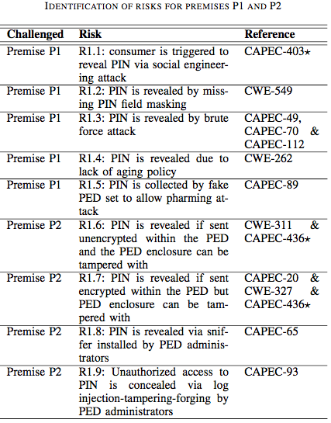

Slide 28
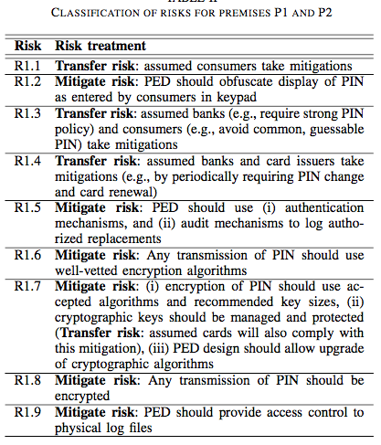

Slide 29
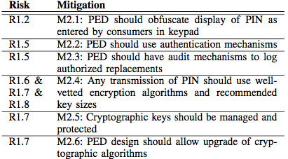
Risk Mitigations

Slide 30
Automated Reasoning
Domain Specific Language (argument), supporting informal and formal specification of Toulmin arguments
Translation from DSL to Decreasoner for event calculus-based reasoning
http://decreasoner.sourceforge.net

Slide 31
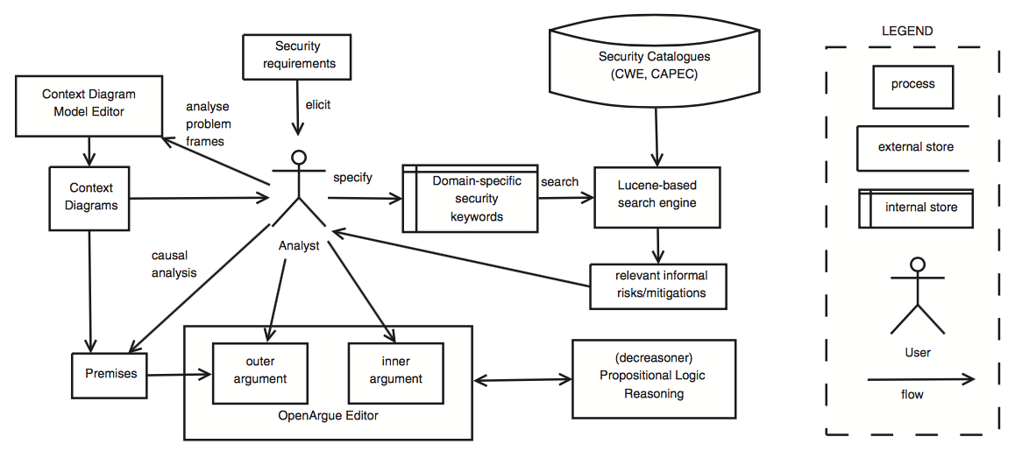
Overview of the RISA tools

Slide 32
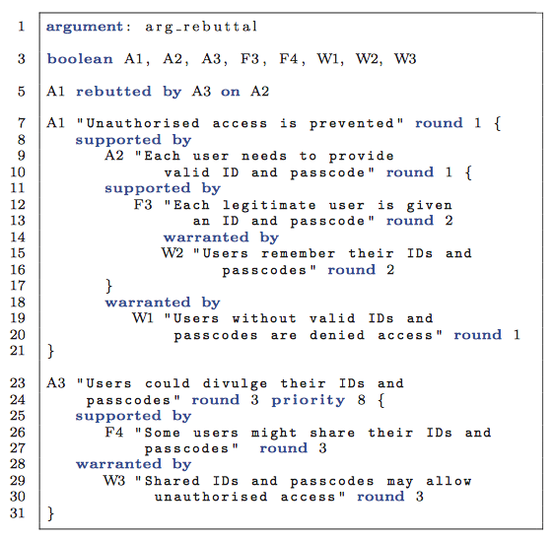
Example Argument

Slide 33
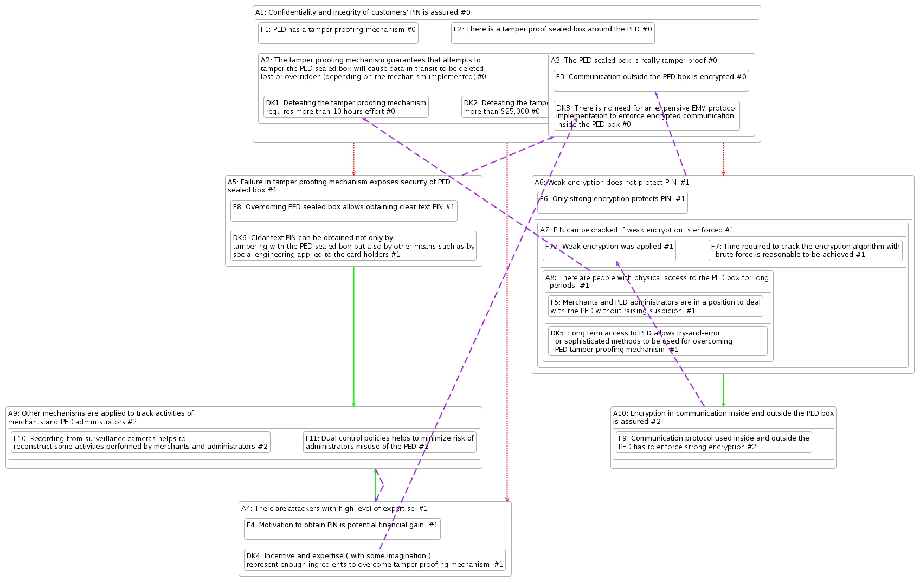
Visualizing the argument graph

Slide 34
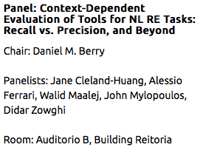
Exercise 2 (offline)
Starting with your problem context, construct a qualitative list of risks to address your security requirements
Without the reasoning tool, can you rank the list by precision/recall or other metrics?

Slide 35
Tool support
Eclipse-based tools
http://sead1.open.ac.uk/risa
http://computing-research.open.ac.uk/trac/openre
Open Source code
https://github.com/problem-frames/openpf
which depends on open-source event calculus reasoning tools (decreasoner)
http://decreasoner.sourceforge.net

Slide 36
A Guided Tour
Risks in life
Qualitative Risk Assessment based on Requirements
Quantitative Risk Assessment based on Requirements
Abstract Goal Behaviors and the Right Hand Side Problems
Quantitative Risk Assessment based on Probabilistic Behavior Models and Requirements
Risk Assessment for Requirements-Driven Self-Adaptive Systems

Slide 37
Quantitative Reasoning of Risks
Risk = Likelihood x Impact
With a list of risk factors, give likelihood from [0,1] and impact arbitrary number, then the total risk of selected risk factors is the sum of risks
Prioritisation, or the 80-20 Pareto rule:
Deal with the risk in the order of HH, (HL | LH), LL
Or simply deal with the higher risks first

Slide 38
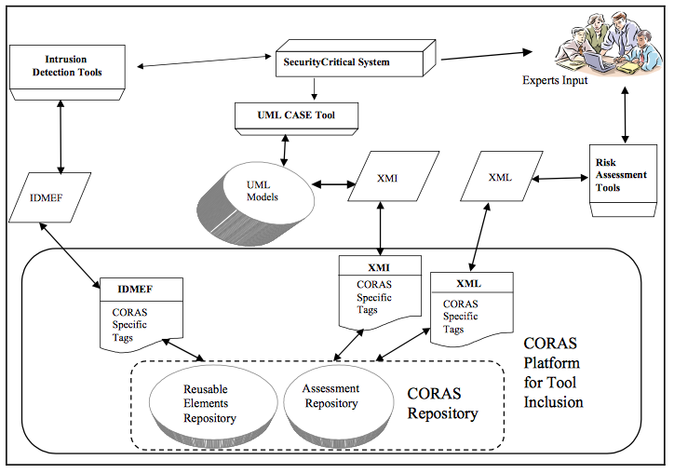
Model-based Risk Assessment
E.g., CORAS: http://coras.sourceforge.net

Slide 39
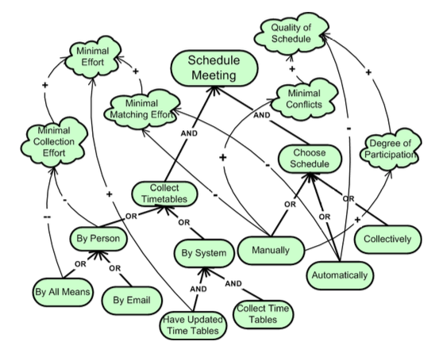
Elicitation of contribution labels of goal models using AHP approach
S. Liaskos, R. Jalman and J. Aranda, "On eliciting contribution measures in goal models," 2012 20th IEEE International Requirements Engineering Conference (RE), Chicago, IL, 2012, pp. 221-230.

Slide 40
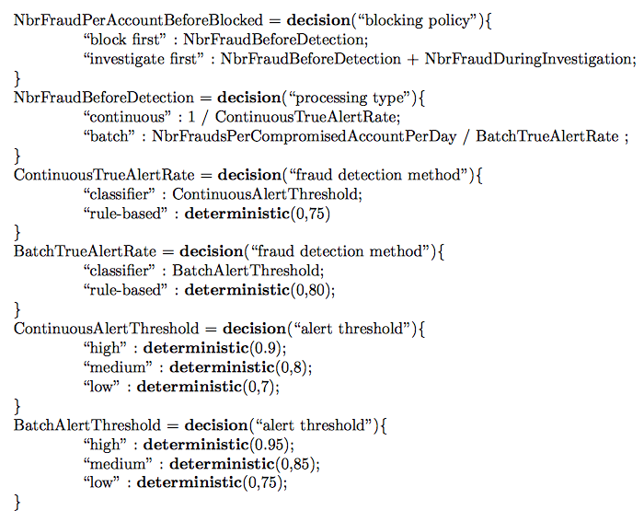
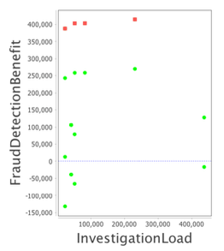
RADAR Approach
Using DSL to specify risks quantitatively on architectural choices (goal alternatives)
Derive Pareto fronts by simulations
https://ucl-badass.github.io/radar/
S. A. Busari, E. Letier, RADAR: A Lightweight Tool for Requirements and Architecture Decision Analysis, Proc. 39th International Conference on Software Engineering 2017 (ICSE 2017).

Slide 41
A Guided Tour
Risks in life
Qualitative Risk Assessment based on Requirements
Quantitative Risk Assessment based on Requirements
Abstract Goal Behaviors and the Right Hand Side Problems
Quantitative Risk Assessment based on Probabilistic Behavior Models and Requirements
Risk Assessment for Requirements-Driven Self-Adaptive Systems

Slide 42
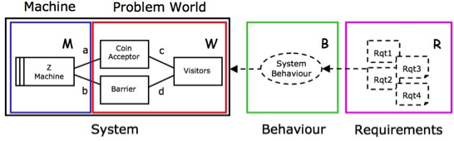
Jackson’s new thoughts
Abstract goal behaviors
Right hand side problem
The Right-Hand Side Problem: Research Topics in RE by Michael Jackson [slides]

Slide 43
A Guided Tour
Risks in life
Qualitative Risk Assessment based on Requirements
Quantitative Risk Assessment based on Requirements
Abstract Goal Behaviors and the Right Hand Side Problems
Quantitative Risk Assessment based on Probabilistic Behavior Models and Requirements
Risk Assessment for Requirements-Driven Self-Adaptive Systems

Slide 44
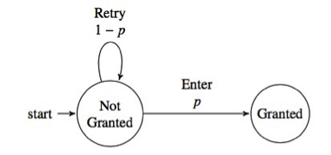
Why consider probabilistic behavior model for risks?
A security example (simplified from PED)
Known unknowns: p the probability

Slide 45
Exercise 3
What is the risk of exposing the bank account to an attacker?
Hint: consider the “traces”, or sequences of transitions in the behavioral model
What are the strategies to reduce the risk? (offline)

Slide 46
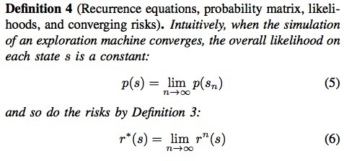
Answer to the first question

Slide 47
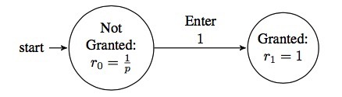
Enumerate all traces and sum

Slide 48
PRISM
Existing work has the following problems: - Cyclic traces
- Symbolic solutions
M. Kwiatkowska, G. Norman, and D. Parker, “PRISM 4.0: Verification of probabilistic real-time systems,” in International Conference on Computer Aided Verification (CAV 2011). Springer Berlin Heidelberg, 2011, pp. 585–591.

Slide 49
Risk Explore tool
Perform symbolic computation of risks
Visualise impact
Efficiently compute minimal risk under symbolic constraints using search-based optimisation algorithms
Armstrong Nhlabatsi, Yijun Yu, Thein Than Tun, Arosha K. Bandara, Niamul Khan, Khaled M. Khan, and Bashar Nuseibeh. “Beyond ‘Access Denied’: Risk-based Exploration of Adaptive Access Control Systems”. Techical Report TR2016-04. The Open University, UK. http://computing-reports.open.ac.uk/2016/TR2016-04.pdf
https://github.com/yijunyu/demo-riskexplore

Slide 50
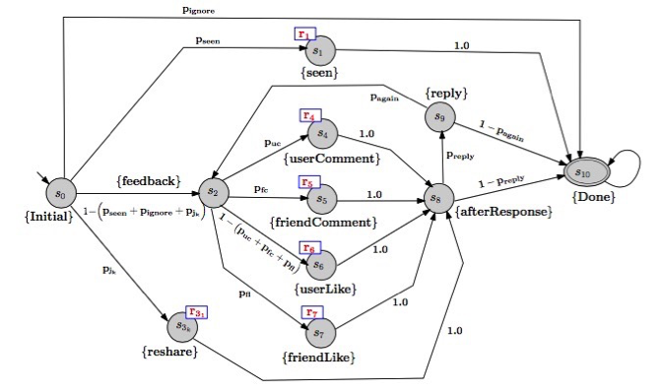
A privacy example
Y. Rafiq, L. Dickens, A. Russo, A. K. Bandara, M. Yang, A. Stuart, M. Levine, G. Calikli, B. A. Price, and B. Nuseibeh, “Learning to share: Engineering adaptive decision-support for online social networks,” in 32nd IEEE/ACM International Conference on Automated Software Engineering (ASE 2017), 30 October - 3 November 2017, University of Illinois at Urbana- Champaign, Illinois, USA., to appear.

Slide 51
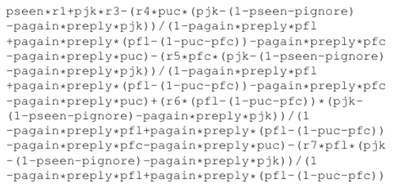
Risk profile function

Slide 52
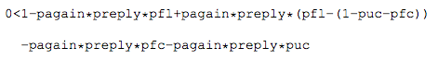
Singularity condition
If r1=r2=r3=r4=r5=r6=r7=1, the minimal risk = 0.012. when
^{pseen = 0.006239582,}
^{pignore = 0.987266657,}
^{pjk = 0.003001324,}
^{puc = 0.115949677,}
^{pfc = 0.446085095,}
^{pfl = 0.131866686,}
^{preply = 0.003728548,}
^{pagain = 0.048901284.}

Slide 53
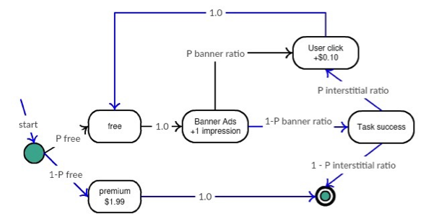
Business requirement example
Android App Advertisement model

Slide 54
Computation results
Risk profile function:
(1-pfree)*Premium+(Impression*pfree)/(1-(pbanner-pinterstitial*(pbanner-1)))-(Click*(pinterstitial*(pbanner-1)-pbanner)*pfree)/(1-(pbanner-pinterstitial*(pbanner-1)))
When Premium=$1.99, Impression=$0.01, Click=$0.10
pfree=1, pbanner=1, pinterstitial=1 // Freemium
If additionally pbanner=0.1, and pinterstitial=0.1, then pfree=0 // Premium
Yijun Yu, Chun Liu. “Little Model in Big Data: An Algebraic Approach to Analysing Abstract Software Behaviours,”. Ruan Jian Xue Bao/Journal of Software, 2016. [doi: 10.13328/j.cnki.jos.000000]

Slide 55
A Guided Tour
Risks in life
Qualitative Risk Assessment based on Requirements
Quantitative Risk Assessment based on Requirements
Abstract Goal Behaviors and the Right Hand Side Problems
Quantitative Risk Assessment based on Probabilistic Behavior Models and Requirements
Risk Assessment for Requirements-Driven Self-Protecting Systems

Slide 56
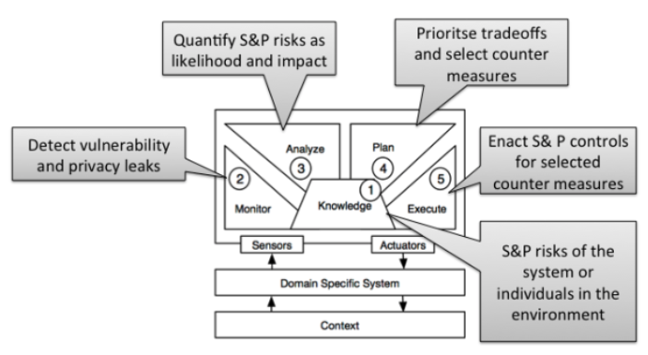
Risk-based Self-Protection architecture
Yu, Yijun and Tun, Thein (2017). Snap Forensics: A Tradeoff between Ephemeral Intelligence and Persistent Evidence Collection. In: 1st International Workshop on Software Engineering and Digital Forensics, 4 September, 2017, Padeborn, Germany.

Slide 57
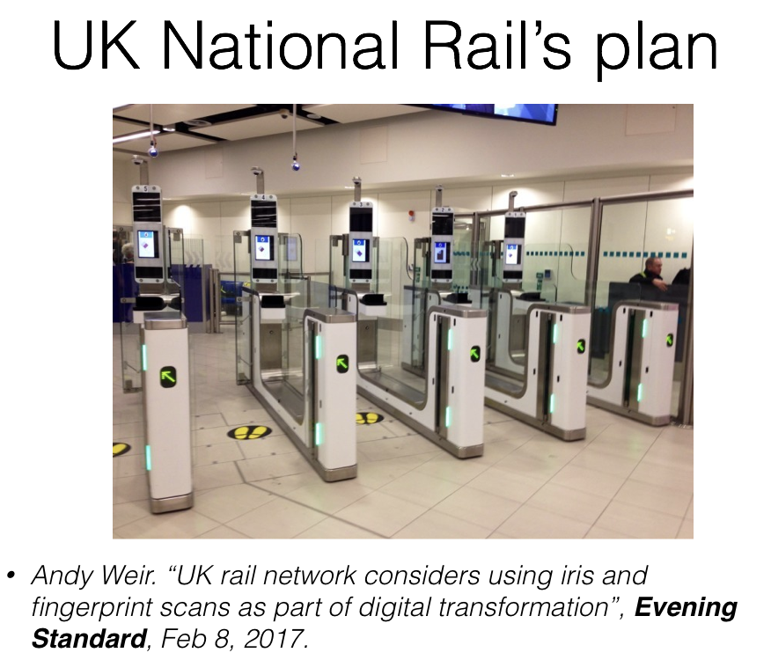

Slide 58
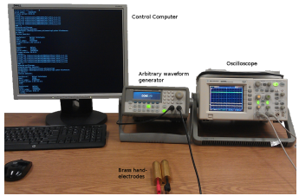
Biometric Authentication
Ivan Martinovic, Kasper Bonne Rasmussen, Marc Roeschlin, Gene Tsudik: Authentication using pulse-response biometrics. Commun. ACM 60(2): 108-115 (2017)

Slide 59
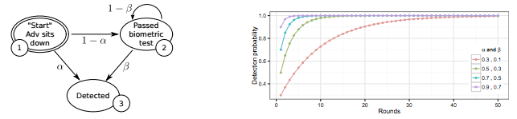
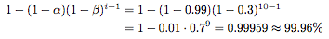
Markov model of continuous authentication and simulation of detection probability

Slide 60
Challenges for Probabilistic Model Checkers
Simulation requires convergence
However, when N approaches infinity, the probability may no longer be a constant
Numeric computations are hard in system identification for self-adaptive systems
Antonio Filieri, Giordano Tamburrelli, Carlo Ghezzi: Supporting Self-adaptation via Quantitative Verification and Sensitivity Analysis at Run Time, TSE’16

Slide 61
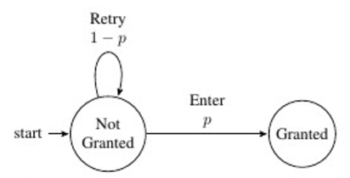
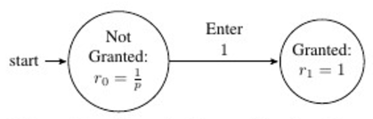
Insight: to remove cycles

Slide 62
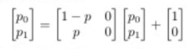
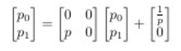
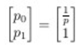
Solving Linear Recurrent Equations

Slide 63
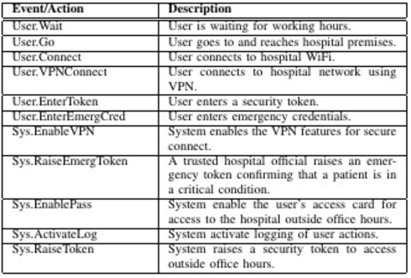
Applied to Adaptive Access Control

Slide 64
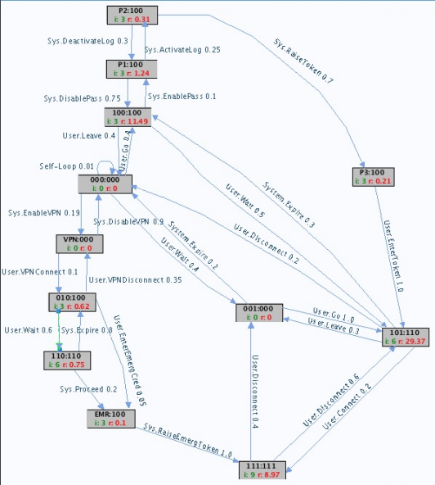
Simulate to Divergence!

Slide 65
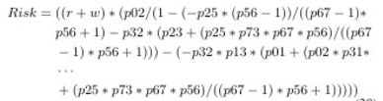
Turn transition probability into independent variables
15 free variables in range [0,1], and 12 reward variables in combination of {READ, WRITE, SHARING}
A risk profile function is thus obtained symbolically, which can print to 5 pages

Slide 66
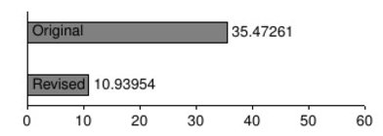
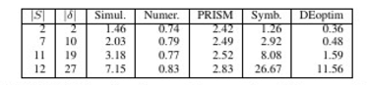
Optimization results (minimal risks)

Slide 67
Parallel composition
E || x_{I} |= G
Given multiple symbolic DTMC’s, compose them in parallel
https://github.com/yijunyu/demo-riskexplore
Compute “adaptive transparency”
Nicholas D’Ippolito, Víctor Braberman, Jeff Kramer, Jeff Magee, Daniel Sykes, Sebastian Uchitel. Hope for the Best, Prepare for the Worst: Multi-tier Control for Adaptive Systems, ICSE’14.

Slide 68
System Model
(locked,out)
P₂
2
1-P₂
2
1-P₁
2
…
P₁
2
(locked,in)
P₁
2
68
P₁
2
1-P₁
2
P₁
2
1-P₁
2
P₁
2
1-P₁
(locked,⊥)
(locked)
(unlocked)
(unlocked,in)
P₁
P₁
1-P₁
1-P₁
1-P₂
2
1-P₁
2
P₁
2
(⊥)
P₁
(unlock,⊥)
(⊥,in)
1-P₂
2
Door of Office
P₁
2
1-P₁
P₂
1-P₂
1-P₁
2
(in)
(unlock,⊥)
(⊥,out)
(out)
P₁
P₂
P₂
1-P₂
1-P₁
P₂
1-P₂
(⊥)
(⊥, ⊥)
User

Slide 69
End of the Tour
Risks in life
Qualitative Risk Assessment based on Requirements
Quantitative Risk Assessment based on Requirements
Abstract Goal Behaviors and the Right Hand Side Problems
Quantitative Risk Assessment based on Probabilistic Behavior Models and Requirements
Risk Assessment for Requirements-Driven Self-Adaptive Systems
If you want to try the tool

Slide 70
Install Docker
https://docs.docker.com/machine/install-machine/#installing-machine-directly
* If you are using Mac OSX
brew install docker-machine
docker-machine create --driver virtualbox default
docker-machine ssh default

Slide 71
How to use our tool?
docker run -it yijun/riskexplore cd /demo ./r examples/PIN

Slide 72
PRISM specification of PIN example
/demo # cat examples/PIN.pm
dtmc
const double p;
const double r1;
const double r2;
module PIN
s : [0..1] init 0;
[]s=0->p:(s'=0)+(1-p):(s'=1);
endmodule
rewards "impact"
s=0: r1;
s=1: r2;
endrewards

Slide 73
examples/composed
examples/PIN
/demo/prism/prism/bin/prism examples/PIN.pm -exportmodel examples/PIN.all -const p=0.1 -const r1=0.1 -const r2=0.1
examples/PIN-symbolic.pm
NormaliseMDP({{p,0},{(1-p),0}},{r1,r2})
r = 0
---
0 | r1/(1-p) |0
1 | r2 |1
p2 = 0
---
0 | 1 |0
1 | 1 |1
i2 = 0
---
0 | r1/(1-p) |0
1 | r2 |1
0<1-p
The total risks is 0 + (r1/(1-p)) + (r2)
P' = 0 1
--- ---
0 | 0 0 |0
1 | 1 0 |1
c' = 0
---
0 | 1/(1-p) |0
1 | 0 |1

Slide 74
Summary and on-going work
Risk based exploration of adaptive systems
Forensic analysis for continuous authentication [CACM’17] and adaptive access control [QNRF]
Proactive forensics [Pasquale et al. RE’13]
Adaptive transparency for security risk assessment [to submit with NII colleague]
Privacy risk and social benefit tradeoffs [TrustCom’14]
Bottom line: self-adaptive systems cannot afford long simulation, hence model-based risk assessment is the most promising approach [Filieri et al, TSE’16]

Slide 75
End of the Tour
Risks in life
Qualitative Risk Assessment based on Requirements
Quantitative Risk Assessment based on Requirements
Abstract Goal Behaviors and the Right Hand Side Problems
Quantitative Risk Assessment based on Probabilistic Behavior Models and Requirements
Risk Assessment for Requirements-Driven Self-Adaptive Systems
Welcome to contact me at: y.yu@open.ac.uk

